Slide 1

Template Fit
Stefan Kluth, Andrea Knue, Sebastian Schulte
24. Januar 2017

Slide 2

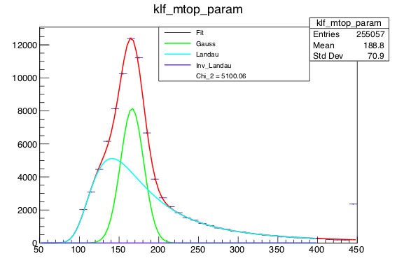
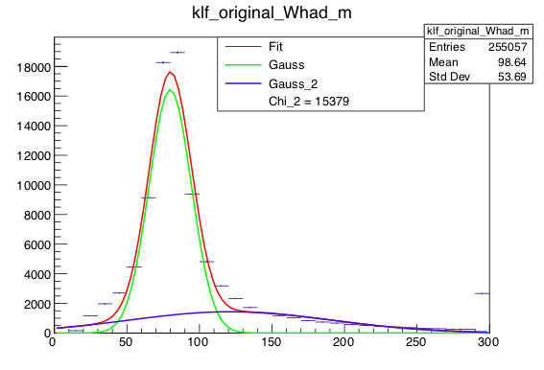
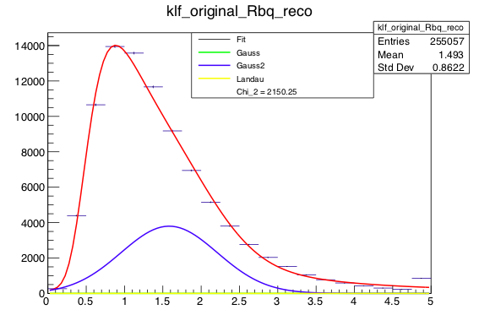

Samples 2015
Motivation Introduction Event selection Event reconstruction BDT Status 8TeV Status 13TeV Summary

Slide 3
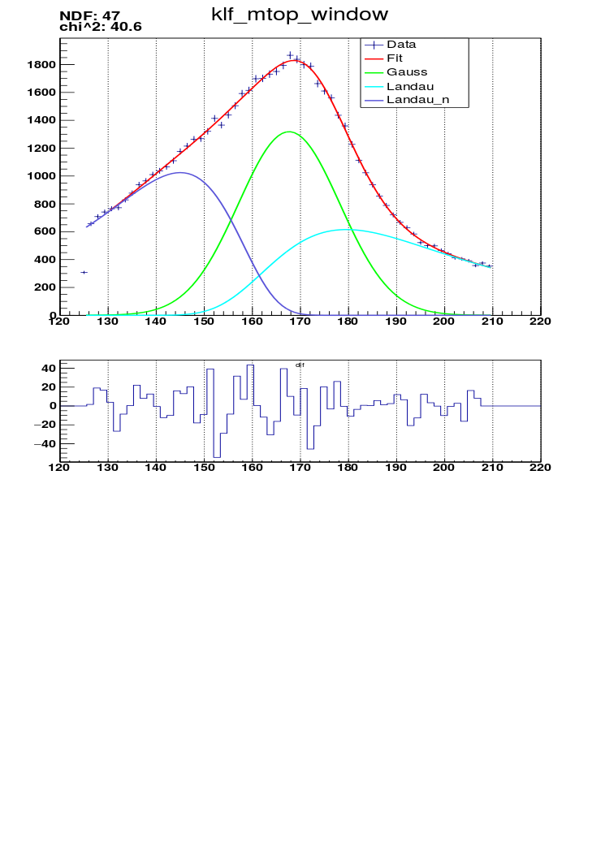
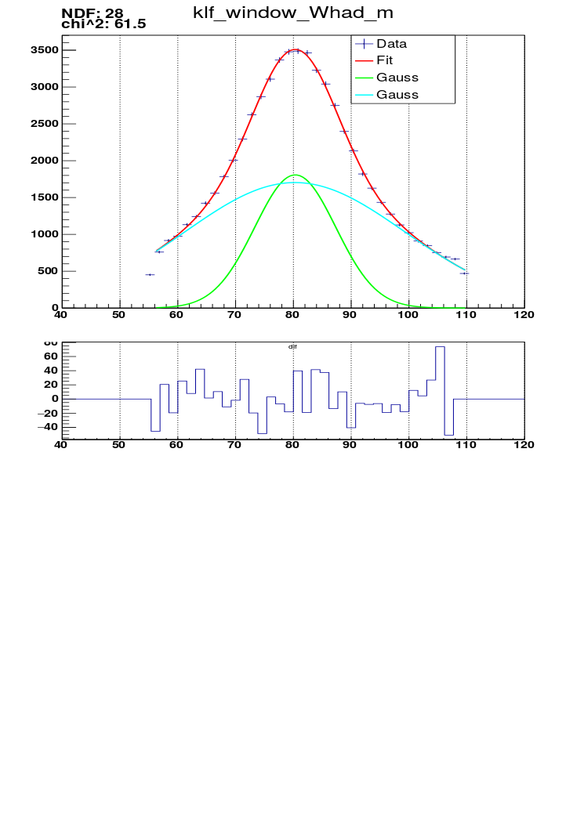
Update
Motivation Introduction Event selection Event reconstruction BDT Status 8TeV Status 13TeV Summary

Slide 4
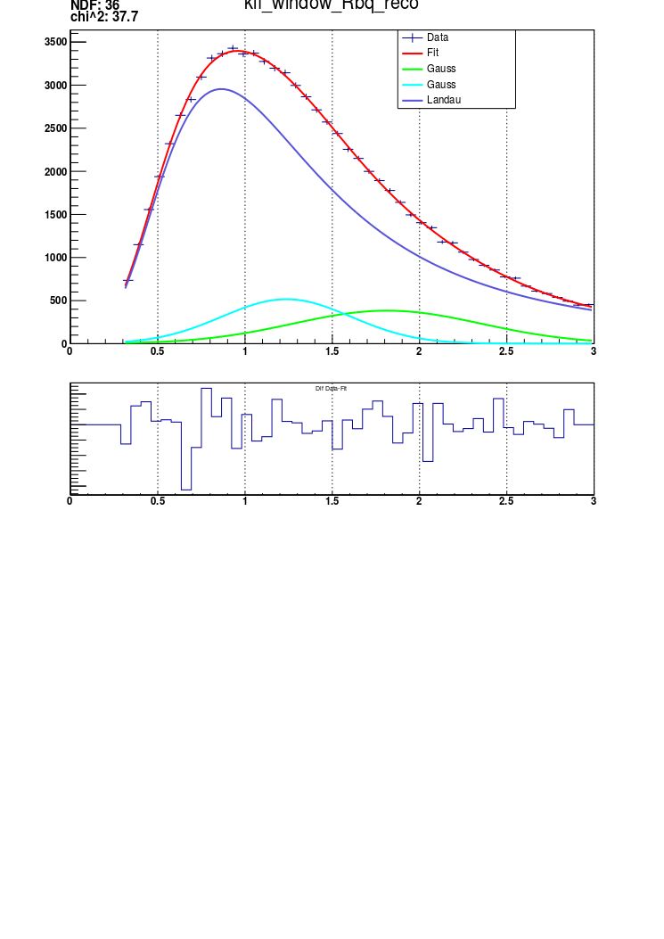
Update
Motivation Introduction Event selection Event reconstruction BDT Status 8TeV Status 13TeV Summary

Slide 5
Backup
Motivation Introduction Event selection Event reconstruction BDT Status 8TeV Status 13TeV Summary

Slide 6


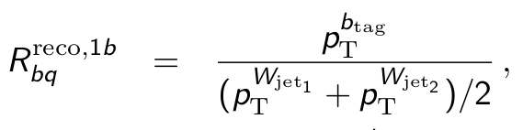
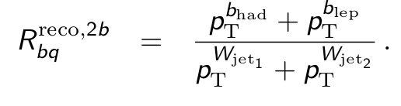
How do we want to measure the top-quark mass?
use same approach as in l+jets channel for 8 TeV:
measurement is based on a 3D-Template method:
    Variable 1: from reconstructed event
    Variable 2: from chosen jet permutation, sensitive to JSF
    Variable 3:
    from chosen jet permutation, sensitive to bJSF
              need full reconstruction of final state
              template parametrisation of the 3 variables
              unbinned likelihood fit is performed
Motivation Introduction Event selection Event reconstruction BDT Status 8TeV Status 13TeV Summary

Slide 7
Plan for 13TeV analysis:
First test: run same workflow as for 8 TeV
Motivation Introduction Event selection Event reconstruction BDT Status 8TeV Status 13TeV Summary

Slide 8
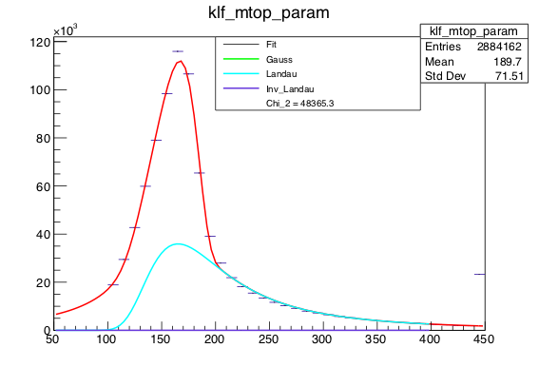
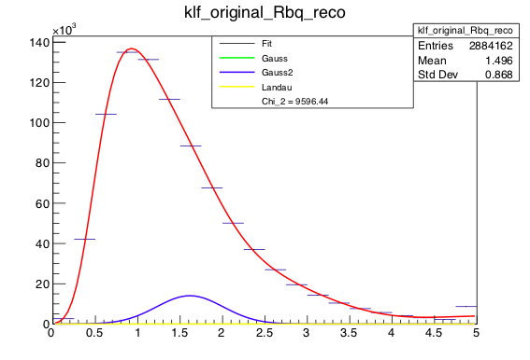
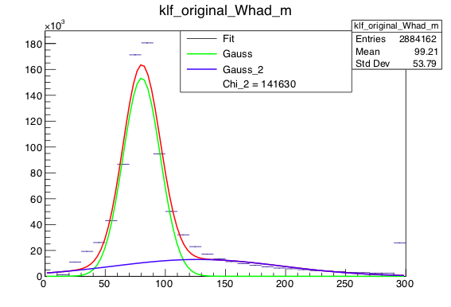
Samples 2016
Motivation Introduction Event selection Event reconstruction BDT Status 8TeV Status 13TeV Summary

Slide 9


Next steps
Improve fit → start parameters
Apply cuts (in PlotFactory)
Improve code
Integrate fit in PlotFactory
Motivation Introduction Event selection Event reconstruction BDT Status 8TeV Status 13TeV Summary

